Slide 1
Highway Materials Lecture - 10
Designed and presented
By
Asst. Prof. Dr. Raquim Nihad Zehawi

Slide 2
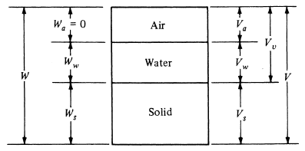
BASIC ENGINEERING PROPERTIES OF SOILS
Phase Relations:
Soils are considered as three-phase systems that consist of air, water, and solids
Porosity (n)
The relative amount of voids in any soil
The ratio of the volume of voids to the total volume of the soil
Void Ratio (e)
the ratio of the volume of voids to the volume of solids
Schematic of the Three Phases of a Soil Mass

Slide 3
Moisture Content (w)
the ratio of the weight of water Ww in the soil mass to the oven dried weight of solids Ws
Degree of Saturation (S)
the percentage of void space occupied by water

Slide 4
Density of Soil
The ratio that relates the mass side of the phase diagram to the volumetric side
Total or bulk density $γ$
Dry density $γ_{d}$
Submerged or buoyant density $γ^{′}$
Total Density $γ$
The ratio of the weight of a sample of soil to the volume
The total density for saturated soils
Dry Density $γ_{d}$
The density of the soil with the water removed
often used to evaluate how well earth embankments have been compacted

Slide 5
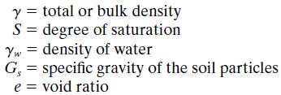
Submerged Density ($γ^{′}$)
the density of the soil when submerged in water
Specific Gravity of Soil Particles
The specific gravity of soil particles is the ratio of density of the soil particles to the density of distilled water
bulk density can be given as:

Slide 6
Example 1
Determining Soil Characteristics Using the Three-Phase Principle
The wet weight of a specimen of soil is 340 g and the dried weight is 230 g. The volume of the soil before drying is 210 cc. If the specific gravity of the soil particles is 2.75, determine the void ratio, porosity, degree of saturation, and dry density.
Solution:
weight of the water
For the volume of the water
For the volume of the solids
For the volume of the air

Slide 7
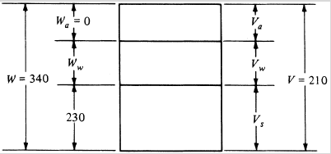
For the void ratio
For the porosity
For the degree of saturation
For the dry density

Slide 8
Example 2
Determining Soil Characteristics Using the Three-Phase Principle
The moisture content of a specimen of soil is 26 percent, and the bulk density is 116 lb/ft3. If the specific gravity of the soil particles is 2.76, determine the void ratio and the degree of saturation.
Solution:
The weight of 1 ft3 of the soil is 116 lb—that is

Slide 10
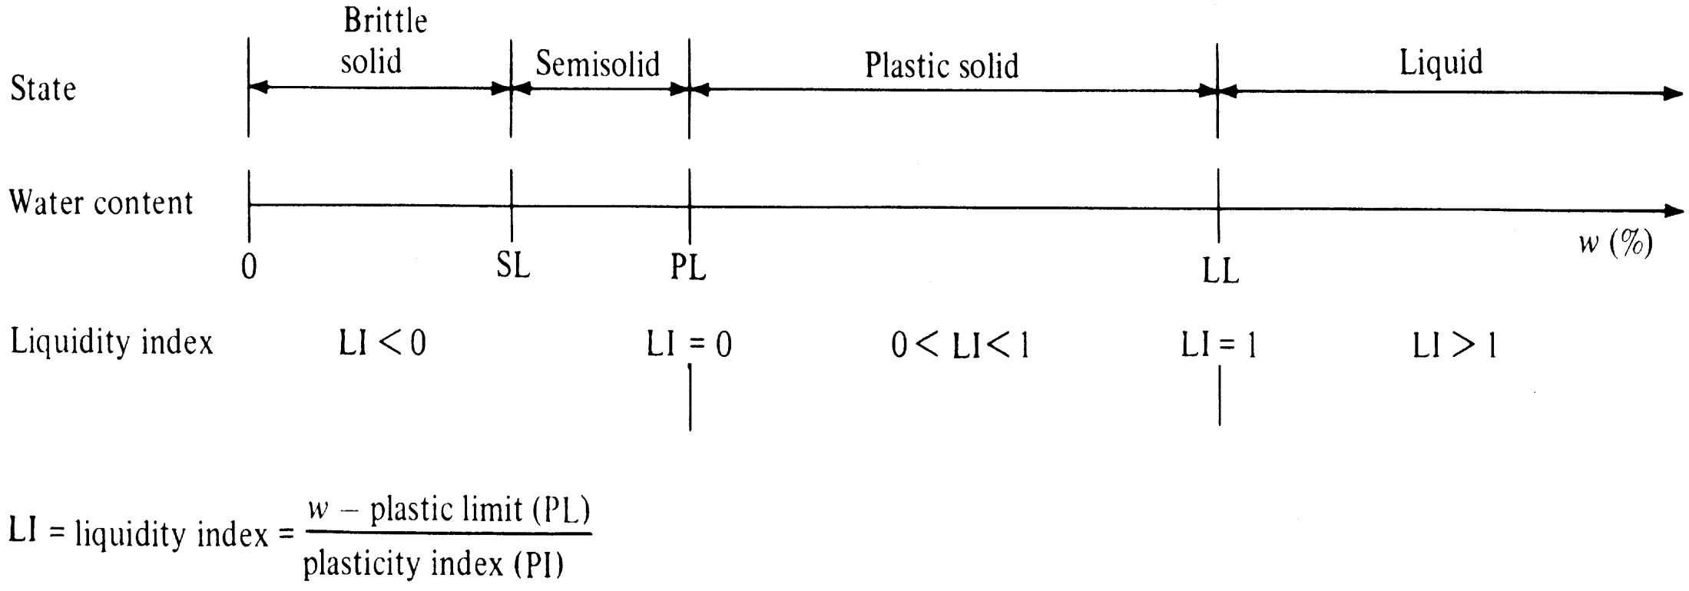
Atterberg Limits
The stiffness or consistency of the soil at any time depends on the state at which the soil is, which in turn depends on the amount of water present in the soil
Atterberg limits: The water content levels at which the soil changes
from one state to the other.
shrinkage limit (SL)
plastic limit (PL)
liquid limit (LL)

Slide 11
shrinkage limit (SL)
When a saturated soil is slowly dried, the volume shrinks
The moisture content at which further drying will not result in additional shrinkage is the Shrinkage Limit
plastic limit (PL)
The moisture content at which the soil crumbles when it is rolled down to a diameter of one-eighth of an inch
The moisture content is higher than the PL if the soil can be rolled down to diameters less than one-eighth of an inch

Slide 12
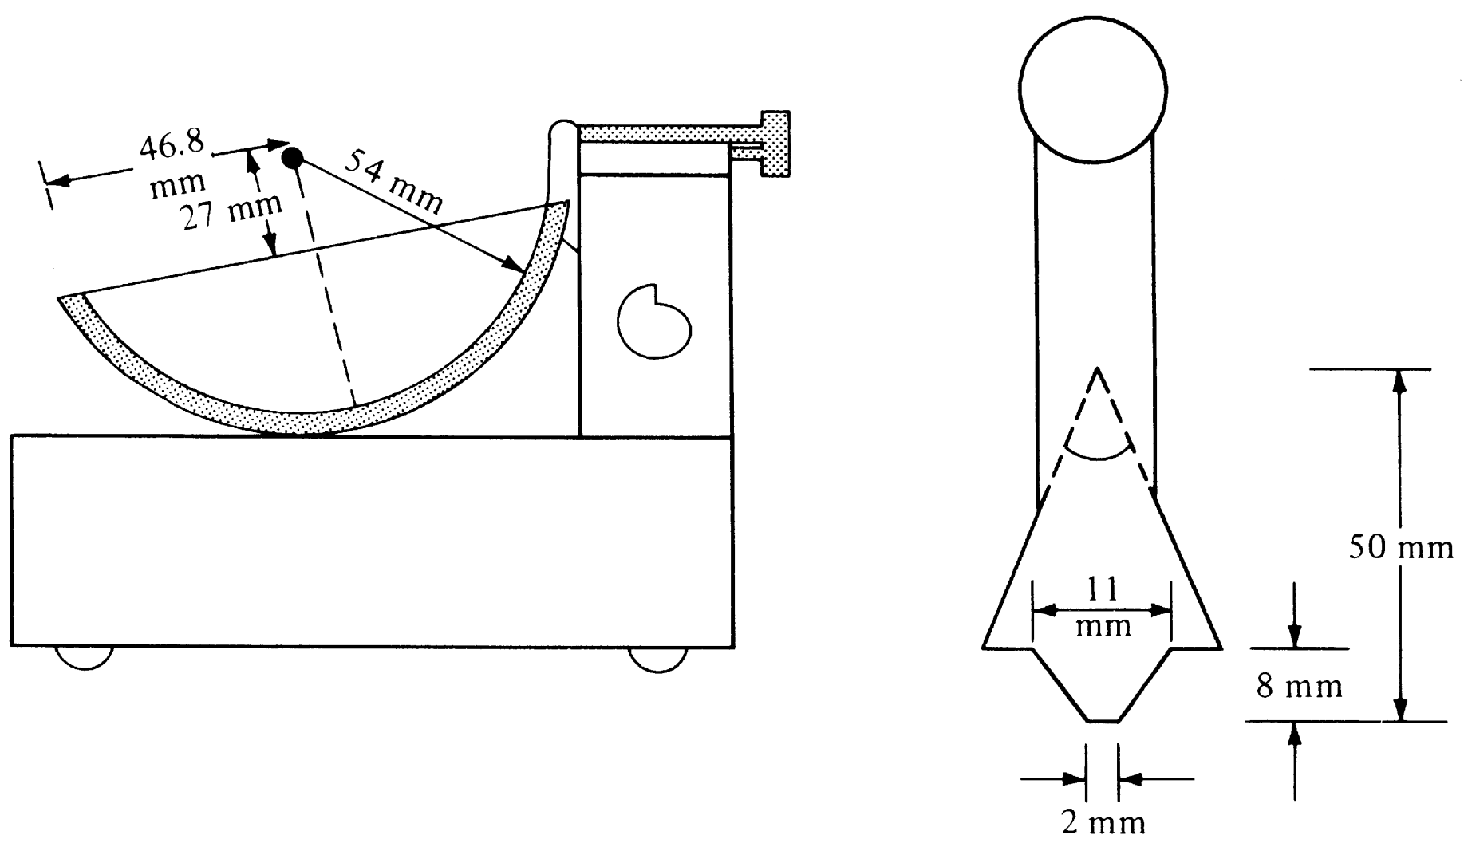
liquid limit (LL)
The moisture content at which the soil will flow and close a groove of one-half inch within it after the standard LL equipment has been dropped 25 times
Schematic of the Casagrande Liquid Limit Apparatus

Slide 13
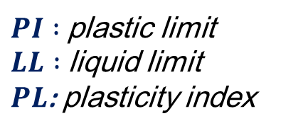
plasticity index (PI)
The range of moisture content over which the soil is in the plastic state is the difference between the LL and the PL is known as the plasticity index (PI)
$PI :$plastic limit
$LL :$ liquid limit
$PL$: plasticity index
$$PI=LL−PL$$
Liquidity Index (LI)
PL and LL can be determined only on remolded soils
These limits may not apply to the undisturbed soil
The structure of the soil particles in the undisturbed state may be different from that in the disturbed state
The liquidity index is used to reflect the properties of the natural soil
$w_{n}$:natural moisture content of the soil
LI: liquidity index

Slide 14
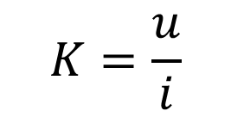
Permeability
The property that describes how water flows through the soil
the coefficient of permeability (K), is the constant of proportionality of the relationship between the flow velocity and the hydraulic gradient between two points in the soil
$$K=\frac{u}{i}$$
$$u=Ki$$
$u$: velocity of water in the soil
$i :$hydraulic gradient $i=\frac{h}{l}$ (head loss $h$ per unit length $l$ )
$K$: coefficient of permeability

Slide 15
CLASSIFICATION OF SOILS FOR HIGHWAY USE
Soil classification is a method by which soils are systematically categorized according to their probable engineering characteristics
The classification of a given soil is determined by conducting relatively simple tests on disturbed samples of the soil
However, the engineering properties of a given soil can be predicted reliably from its classification, this should not be regarded as a substitute for the detailed investigation of the soil properties
The most commonly used classification systems
AASHTO Classification System
Unified Soil Classification System (USCS)

Slide 16
AASHTO Classification System
This system has been described by AASHTO as a means for determining the relative quality of soils for use in:
Embankments
Subgrades
Subbases
Bases
soils are classified into seven groups, A-1 through A-7, with several subgroups
The classification is based on its particle size distribution and the Atterberg limits, (LL, and PI).

Slide 17
Soils are evaluated within each group by using an empirical formula to determine the group index (GI) of the soils, given as
The GI is determined to the nearest whole number

Slide 18
Granular soils fall into classes A-1 to A-3 are:
A-1 soils consist of well-graded granular materials
A-2 soils contain significant amounts of silts and clays
A-3 soils are clean but poorly graded sands.
When soils are properly drained and compacted, their value as subgrade material decreases as the GI increases
A soil with a GI of zero (an indication of a good subgrade material) will be better as a subgrade material than one with a GI of 20 (an indication of a poor subgrade material).

